Slide 1





An Open Platform for Simulating the Physical Layer of 6G Communication Systems with Multiple Intelligent Surfaces
18th International Conference on Network and Service Management CNSM 2022
ALEXANDROS PAPADOPOULOS^{1,2}, Antonios Lalas², Konstantinos Votis², Dimitrios TYROVOLAS³,GEORGE KARAGIANNIDIS³, SOTIRIS IOANNIDIS⁴, CHRISTOS LIASKOS^{1,4}
¹ Department of Computer Science and Engineering, University of Ioannina ² Information Technologies Institute, Center for Research and Technology Hellas
³ Department of Electrical and Computer Engineering, Aristotle University of Thessaloniki
⁴ Foundation for Research and Technology - Hellas

Slide 2



Supported by the European Union's Horizon 2020 Research and Innovation Programme: SHared automation Operating models for Worldwide adoption (SHOW) under Grant Agreement No. 875530
Supported by the European Union's Horizon 2020 Research and Innovation Programme: COmprehensive cyber-intelligence framework for resilient coLLABorative manufacturing Systems (COLLABS) under Grant Agreement No. 871518
Supported by WISAR (Foundation for Research and Technology–Synergy Grants 2022) for theoretical design.
https://show-project.eu/
https://www.collabs-project.eu/

Slide 3
Presentation Outline
Objectives
Methodology
RIS in a nutshell
Optimization workflow of RIS’ configuration
6G-Simulation Platform
Architecture of Platform
Demo
Conclusions
Future Work

Slide 4
Objectives
A physics simulation platform for studying the communication between RIS pair.
The simulation platform is open source. Available in : https://github.com/alexpapad95/6G-simulation-platform
Enabling a variety of application domains such as Autonomous Vehicles and Physical Cybersecurity defense mechanisms.

Slide 5
Methodology
The platform offers accurate electromagnetic propagation between two RIS units.
Each RIS consists of unit cells; groundplane, substrate and Square-Split-Resonator Ring.
Each unit cell hosts a port that can be active or passive.
All the elements of the RIS1 are active and all the elements of RIS2 are passive.
The setup can emulate:
RIS-RIS communication link
Transmitter-RIS communication link
RIS-receiver communication link
Transmitter-RIS-RIS-receiver communication link

Slide 6
RIS in a nutshell
In 6G networks, the communication environment is not considered as given. Environmental fading and scattering stop to be uncontrollable phenomena. They are parameters of the system that could be optimized.
The main technology in the manipulation of communication environment is Reconfigurable Intelligent Surfaces (RISs).
RISs are 2D metasurfaces with reconfigured electric permittivity and permeability.
RIS can be engineered in real-time to obtain a required macroscopic electromagnetic behaviour in different frequency bands.

Slide 7
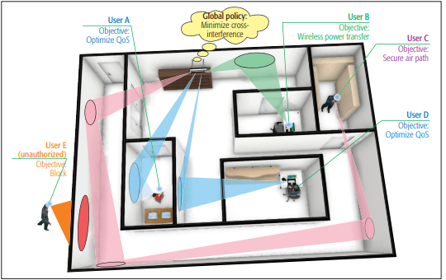
RIS in a nutshell
Some use cases of RIS are:
Recovery of Non-Line-of-Sight connection between the transmitter and the receiver.
Optimization of the QoS of the users.
Minimization of the cross-reference.
Transfer of wireless power.
Block of the unauthorized users.

Slide 8
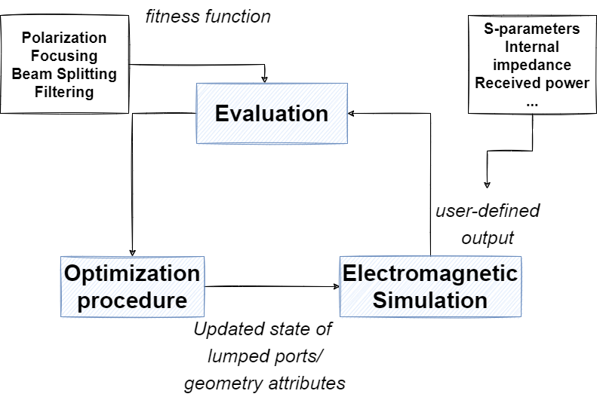
Optimization workflow of RIS’ Configuration

Slide 9
Optimization workflow of RIS’ Configuration

Slide 10
Optimization workflow of RIS’ Configuration

Slide 11
Optimization workflow of RIS’ Configuration

Slide 12
Optimization workflow of RIS’ Configuration

Slide 13
Optimization workflow of RIS’ Configuration

Slide 14
Optimization workflow of RIS’ Configuration

Slide 15
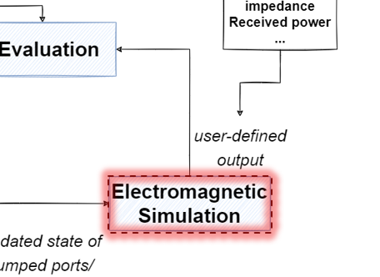
6G-Simulation Platform
The platform is based on openEMS and MATLAB/Octave.
The openEMS is an open-source FDTD electromagnetic solver.
The platform provides the tool for exploring the wireless propagation environment between RIS units in any ecosystem.

Slide 16
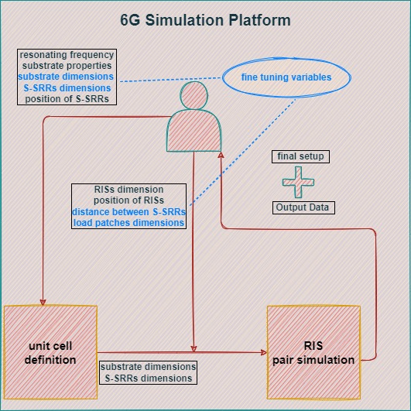
6G-Simulation Platform
The output data are:
The feed point impedance.
The incoming, reflected and accepted power.
The reflection and transmission coefficients of the ports (s-parameters).
The resonating frequency in which the reflection coefficients of the active ports are minimized.
The values of frequency in which the active ports exhibit the maximized transmission coefficients with the passive ones.

Slide 17
Conclusions
The platform can simulate RIS pairs of any composition and dimensions, and at varying distances between them.
The platform provides facilities for pinpointing the resonating frequency of the defined RIS pair, and then for optimizing the energy flow from one to the other.
The platform can be employed not only for studying the RIS-RIS communication, but also for the MIMO(user)-RIS part of a communication.

Slide 18
Future Work
Creating realistic channel models for indoor and outdoor, RIS enabled environments, such as V2X infrastructure in AVs, enabling also cybersecurity aspects.
Exploitation of the data for ML/AI models.

Slide 19
Thank you for your attention!

